Slide 1
Black Team AAR

Slide 2
Setup
Monday:
All 80 boxes + spares were imaged
Tuesday:
All networking core networking was setup (2 3750’s, 1 nexus, PA)
Voip was setup ( Thanks to Bruce Heartpence)
Wednesday
Moving team boxes to rooms

Slide 3
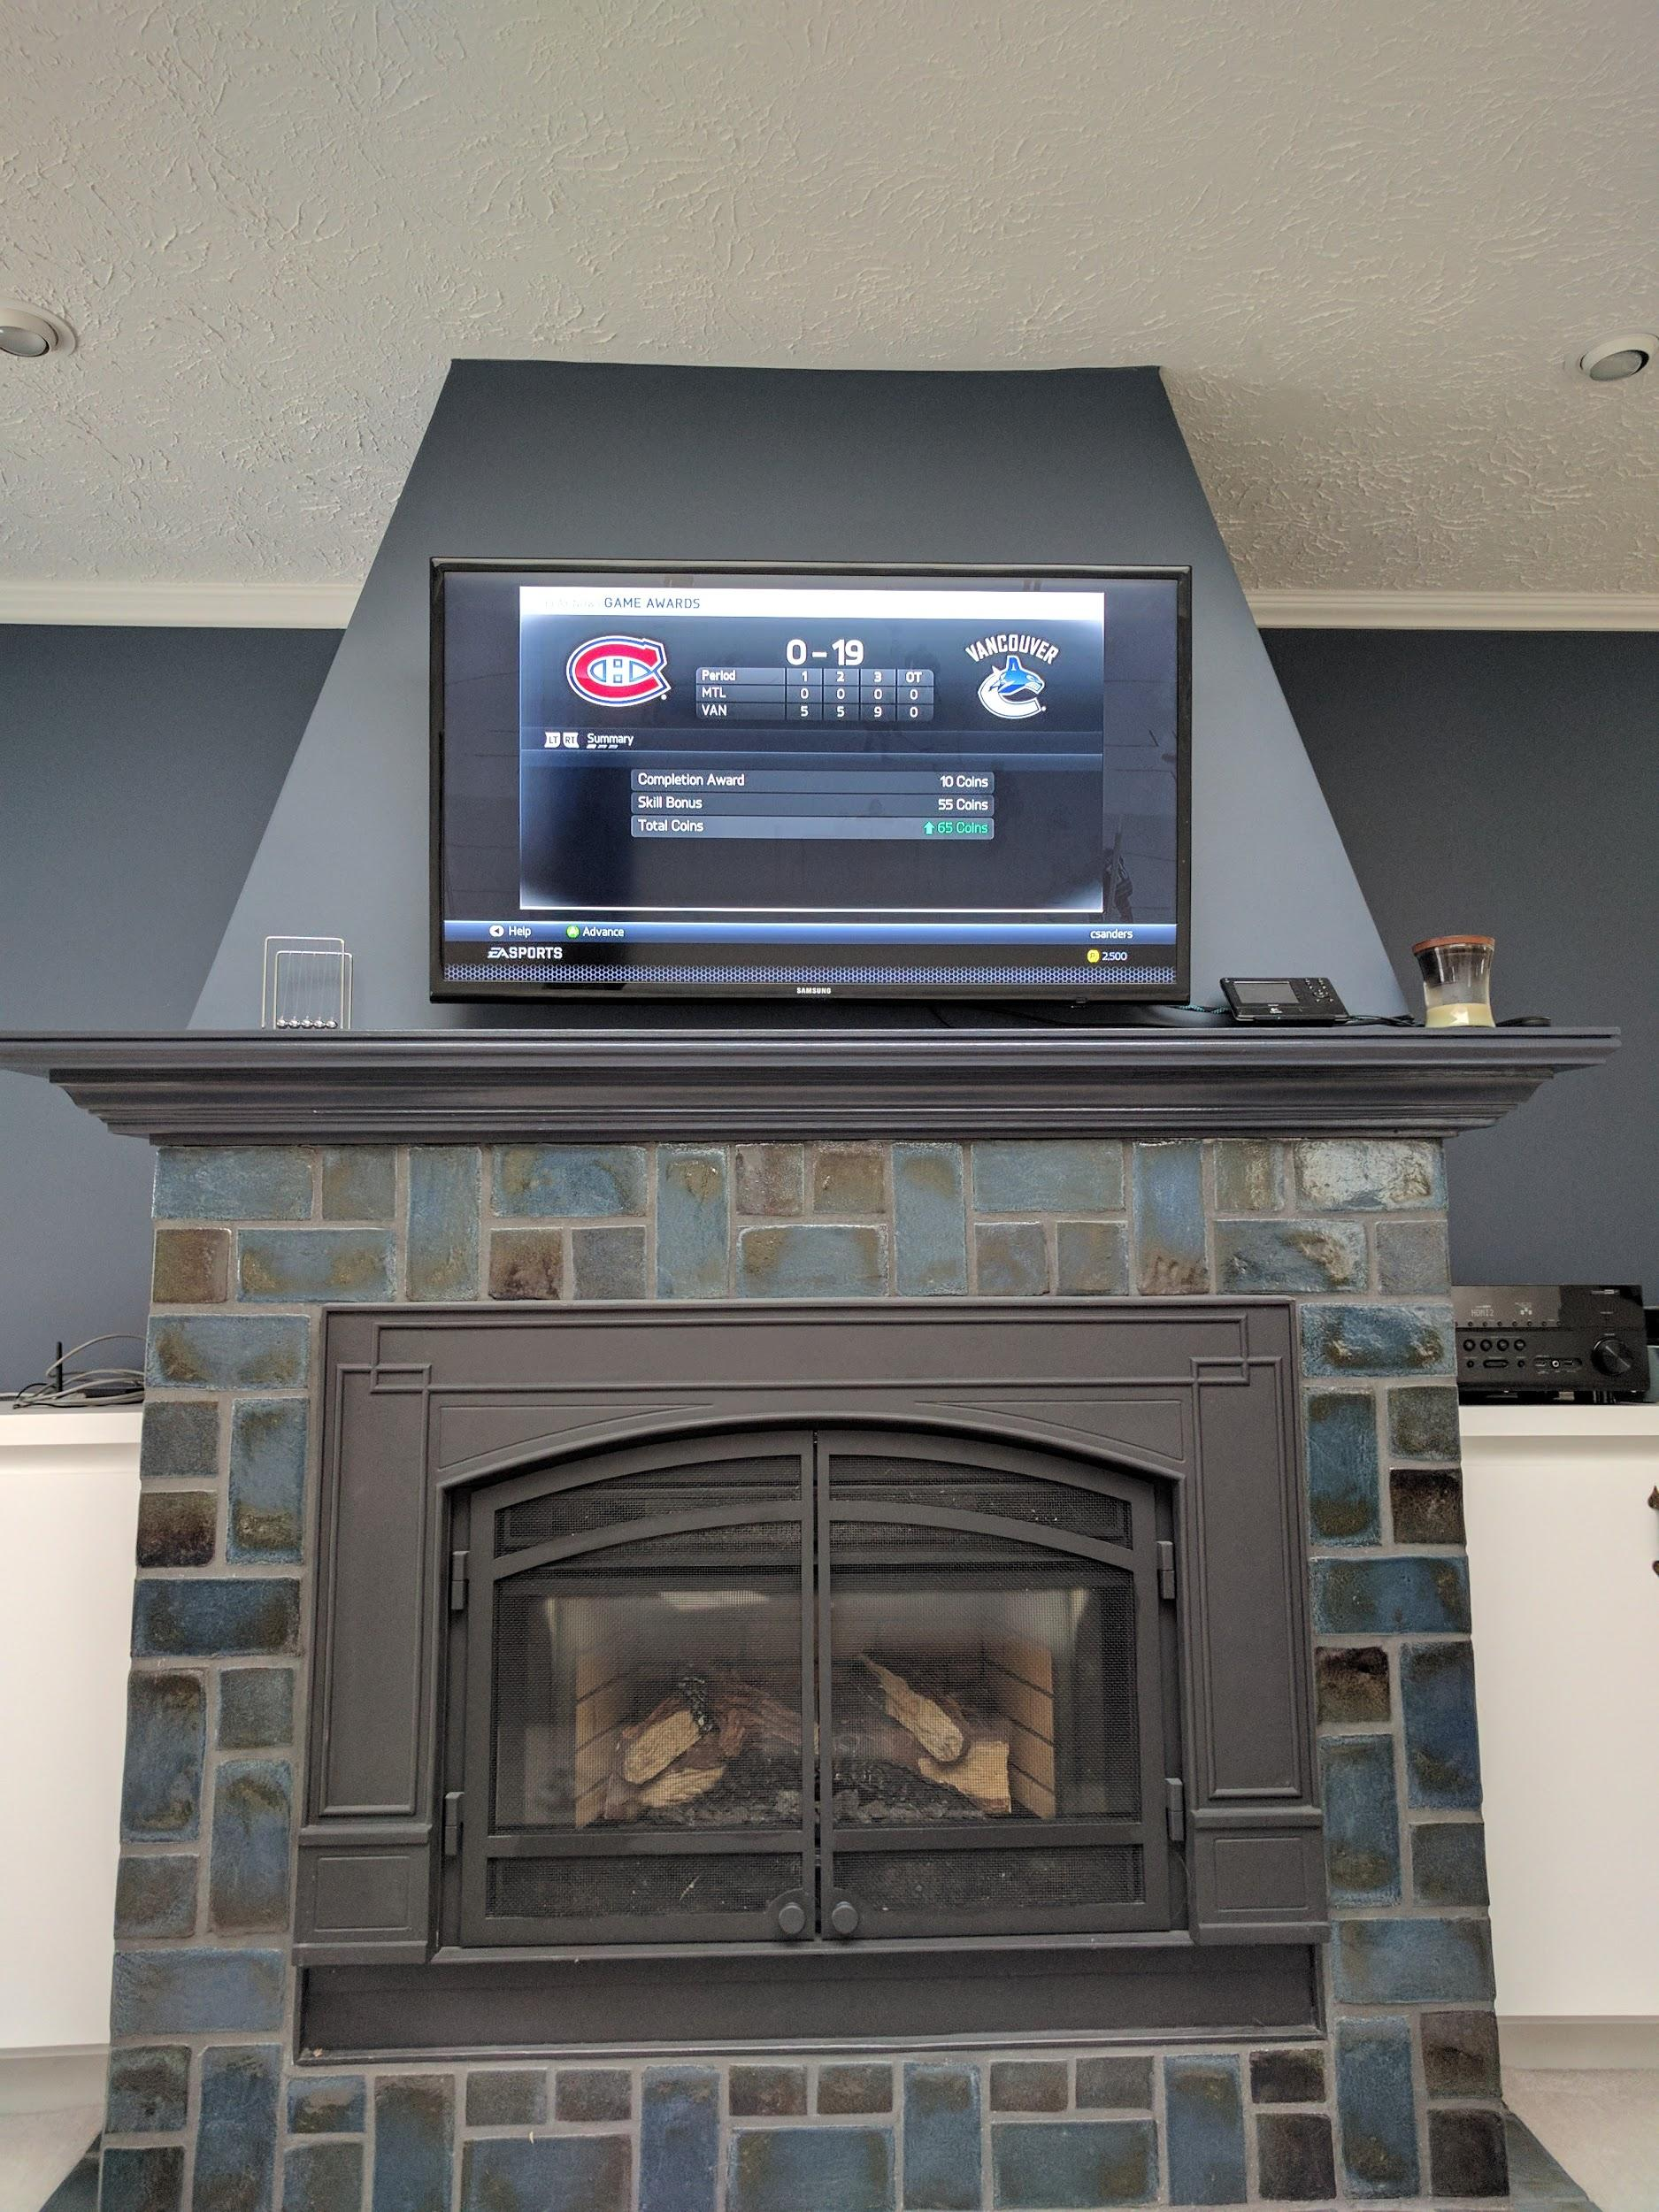
The setup
Early end to day 2 … # snow
So we play #Chel
That is Bryan losing to Chaim
Final Score: 19-0

Slide 4
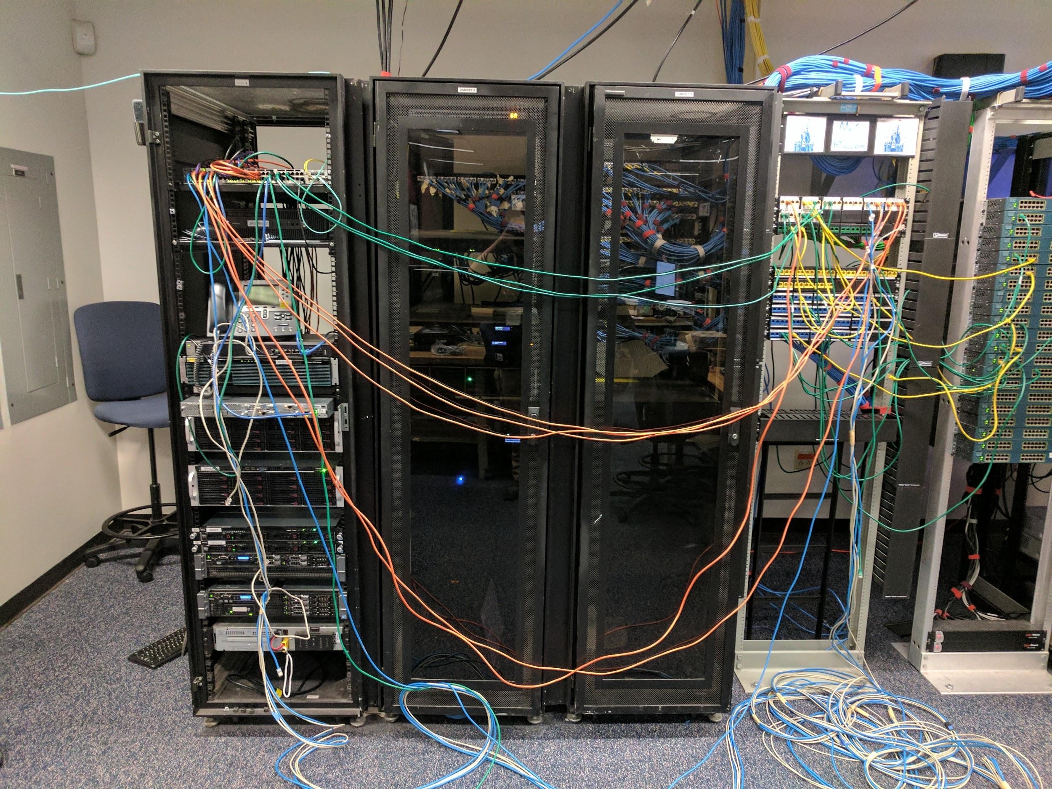
Core and DevCloud

Slide 5
Setup part 2
Thursday:
Scoring Engine brought up
Cable crimping (Thank you to Aiden)
Ansible deploys (All Windows, Linux, AWS, Foreman, routers)
Friday:
Git and Jenkins brought up
Board was made green
AWS Scoring was fixed (thanks red team)

Slide 6
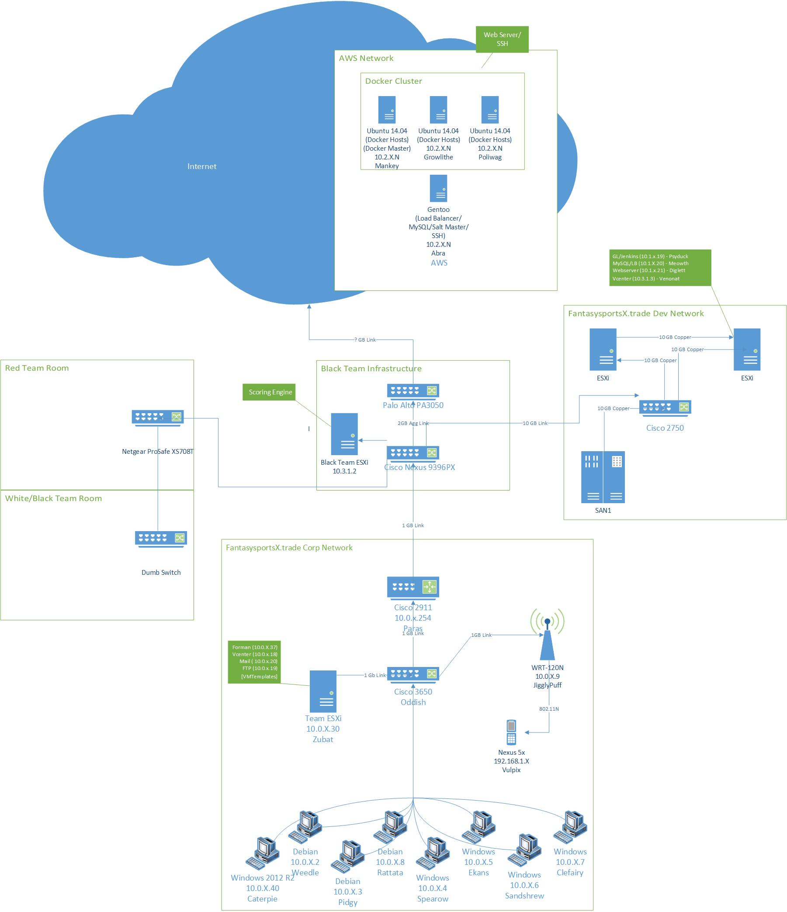
Notes:
psexec

Slide 7
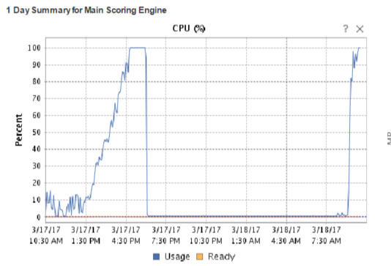
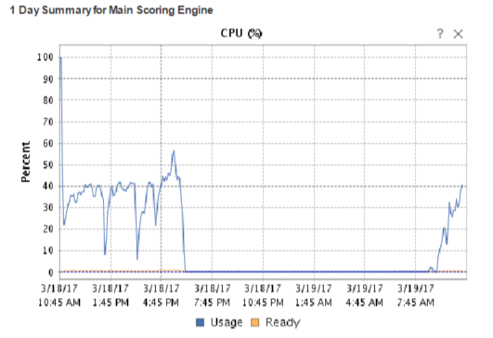
Give more CPU to Scoring engine main

Slide 8
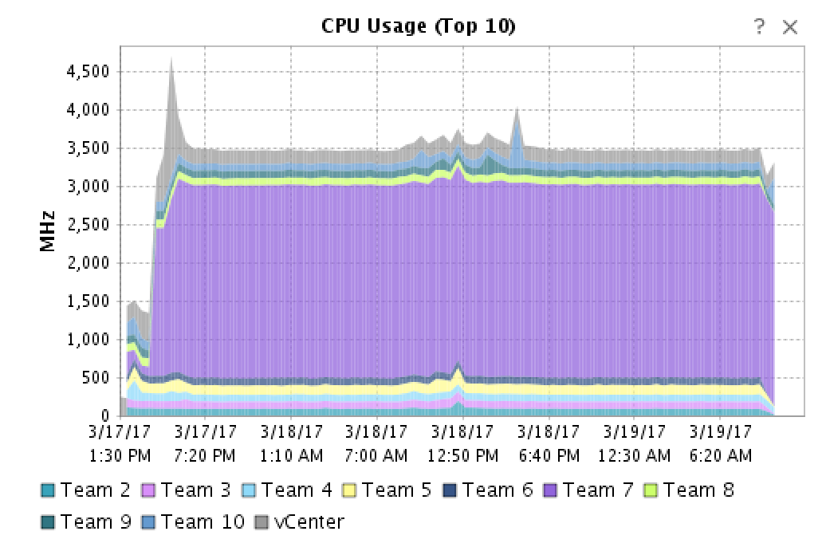
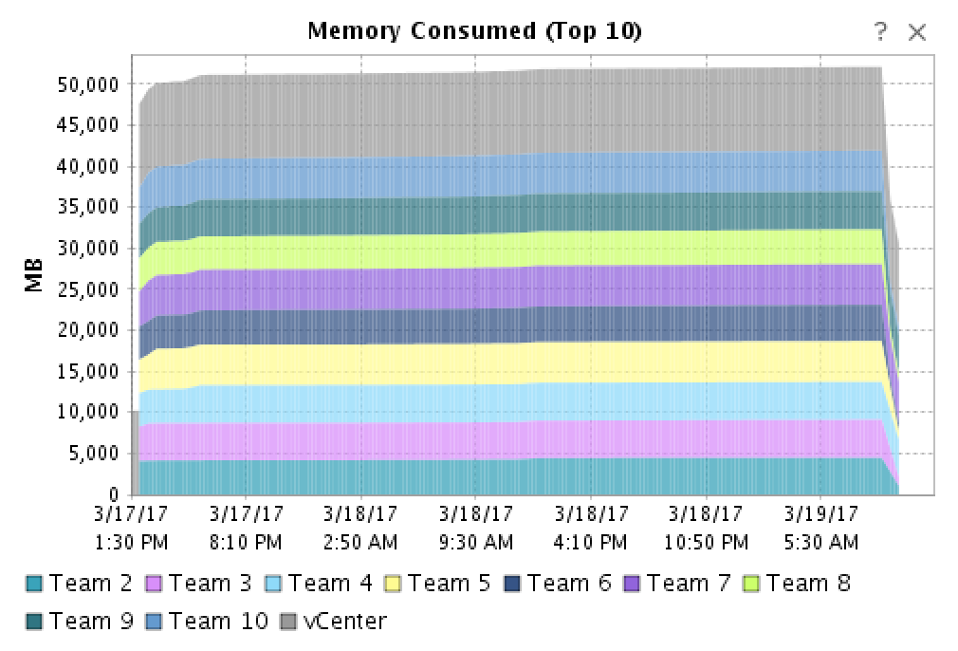
DevCloud Utilization
Team 7 used more CPU than anything else...

Slide 9
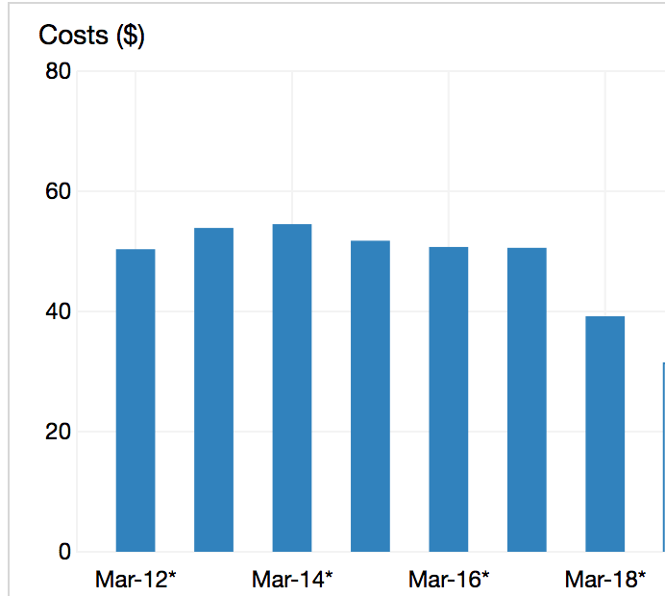
AWS Costs Per Day
46 EC2 boxes
30 - Ubuntu (Mankey/Poliwag/Growlith)
10 - Gentoo (Abra)
6 - Black Team Dev
Each box: 2 vCPUs/4GB RAM

Slide 10
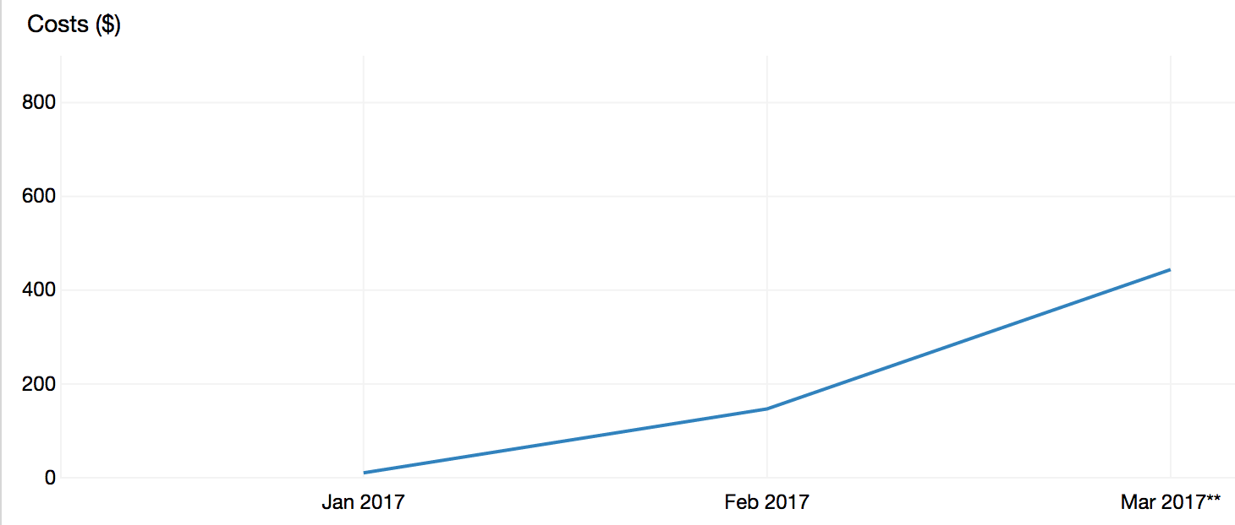
AWS Total Cost

Slide 11
Shamoon
Went off earlier than expected.
Propagated from Win client boxes to DC.
Wasn’t supposed to target DC
Wiped MBR.

Slide 12
Check Summary
Round Timing | Between 1 and 10 minutes to score a round, 5 minute break between rounds
Number of Checks Per Round | 23
Number of Service Points Per Round | 1300
Number of Rounds | 121
Number of Checks | 2783 per team / 27830 total
Number of Service Points Possible | 157,300
Number of Fails (All teams) | 10,841
Number of Passes (All teams) | 16,989

Slide 13
Services that had a good time… (# of check fails)
Service Name | Day 1 | Day 2 | Day 3 | Overall
HTTP-Meowth-33 | 3 | 14 | 1 | 18
HTTP-1-Diglett-33 | 11 | 31 | 106 | 148
SSH-Meowth-34 | 36 | 94 | 21 | 151
SSH-Diglett-34 | 45 | 55 | 97 | 197
HTTP-2-Diglett-33 | 25 | 96 | 136 | 257
FTP-Voltorb-50 | 52 | 107 | 135 | 294
HTTPS-Zubat-100 | 30 | 136 | 136 | 302
HTTPS-Snorlax-100 | 35 | 138 | 136 | 309
Total | 330 | 690 | 190 | 1210

Slide 14
Services that had a rough time… (# of check fails)
Service Name | Day 1 | Day 2 | Day 3 | Overall
SSH-Growlith-50 | 91 | 298 | 133 | 522
SSH-Mankey-50 | 82 | 340 | 151 | 573
MySQL-Mankey-50 | 86 | 358 | 167 | 611
Fsports-Vulpix-75 | 158 | 428 | 154 | 740
SMB-Magikarp-50 | 89 | 494 | 180 | 763
POP3-Bellsprout-50 | 201 | 562 | 165 | 930
SMTP-Bellsprout-50 | 201 | 562 | 167 | 930
IMAP-Bellsprout-50 | 204 | 565 | 167 | 934
Total | 330 | 690 | 190 | 1210
Notes:
Explain AP

Slide 15
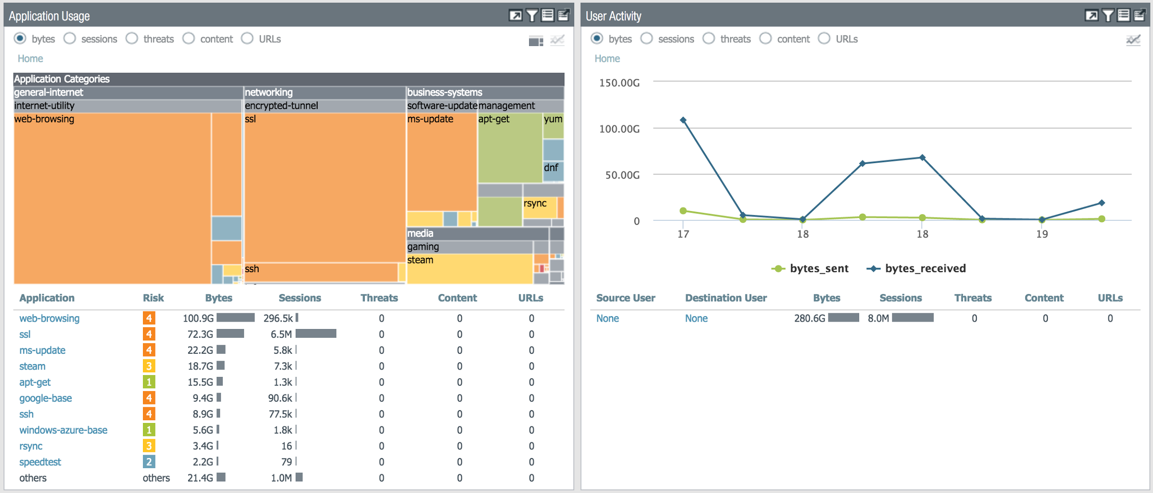
Internet Usage

Slide 16
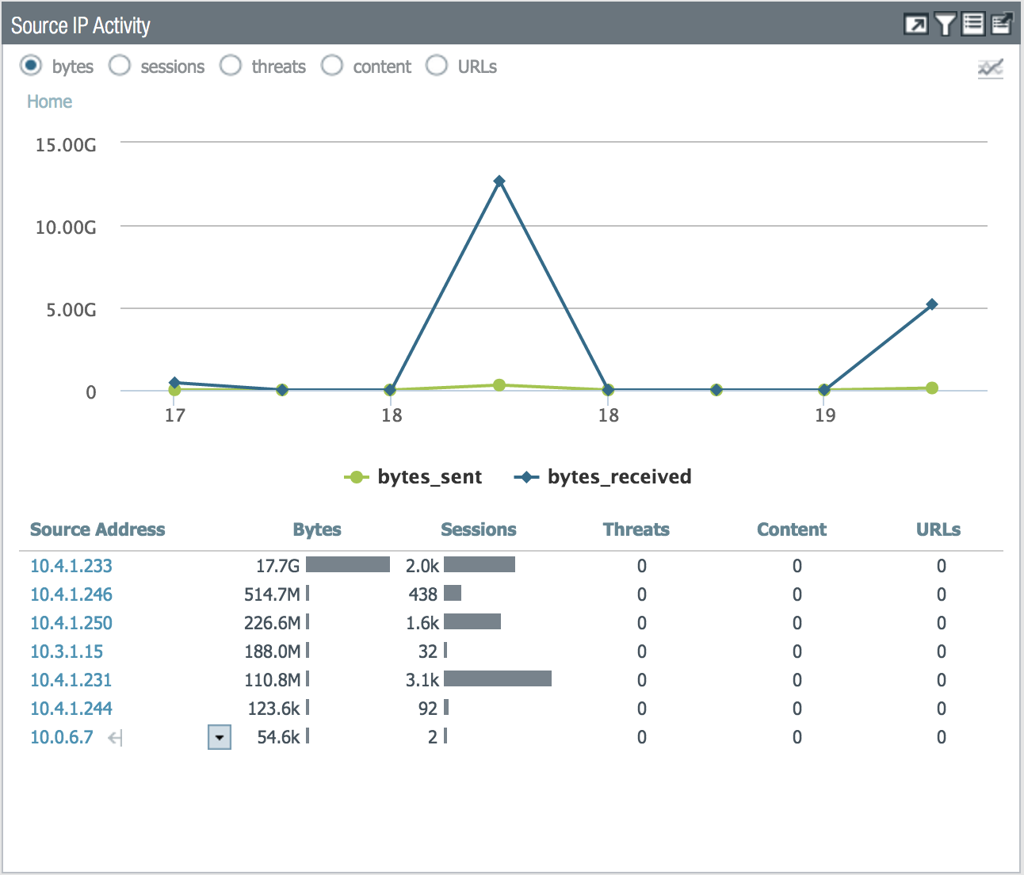
So..Steam?
Ya..so Black Team got bored on Saturday.

Slide 17

Open Sourcing Our Repo
https://github.com/bjh7242/NECCDC-2017-Configs
Ansible playbooks for systems, services, vulns, AWS, network, core infrastructure, etc
Team web application (that wasn’t deployed)
Amazon AMI images have been made public so that you can rebuild the cloud infrastructure IN YOUR OWN ROOM!

Slide 18




#blueteambird

